Slide 1
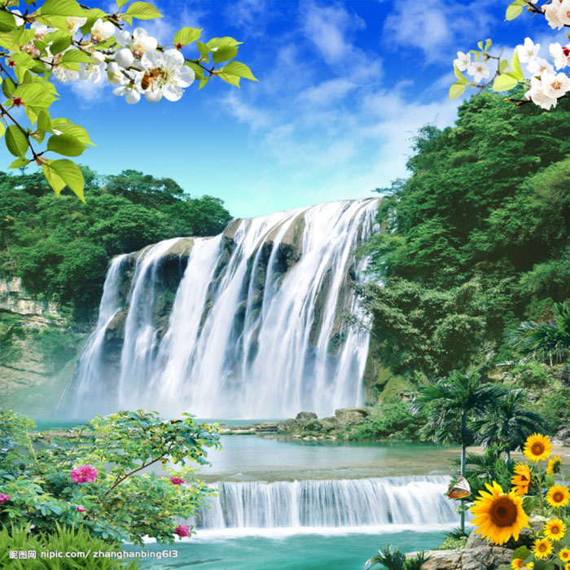
Over and over
I never dare to reach for the moon I never thought I'd know heaven so soon I couldn't hope to say how I feel The joy in my heart no words can reveal
Now just a memory the tears that I cried Now just a memory the sighs that I sighed Dreams that I cherished all have come true All my tomorrows I give to you
Life's summer leaves may turn into gold The love that we share will never grow old Here in your arms no words far away Here in your arms forever I'll stay
Over and over I whisper your name Over and over I kiss you again I see the light of love in your eyes Love is forever, no more good-byes
WELCOME TO OUR CLASS

Slide 2
Unit 5: Natural wonders of Viet Nam
LESSON 5
Reading and writing

Slide 3
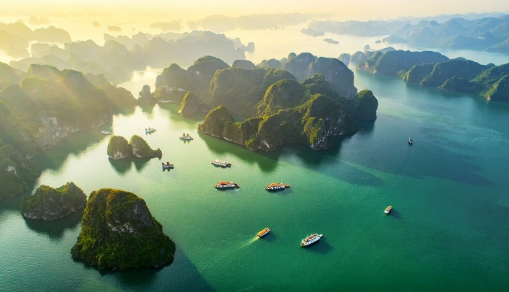
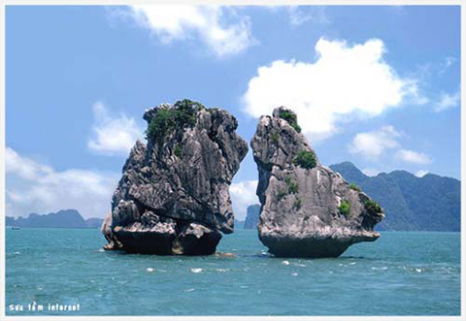
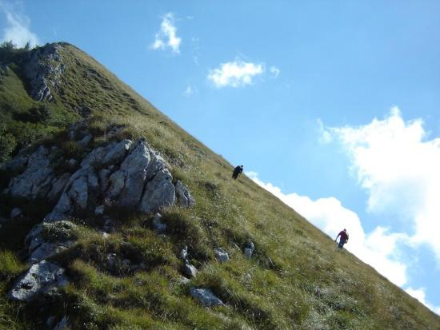
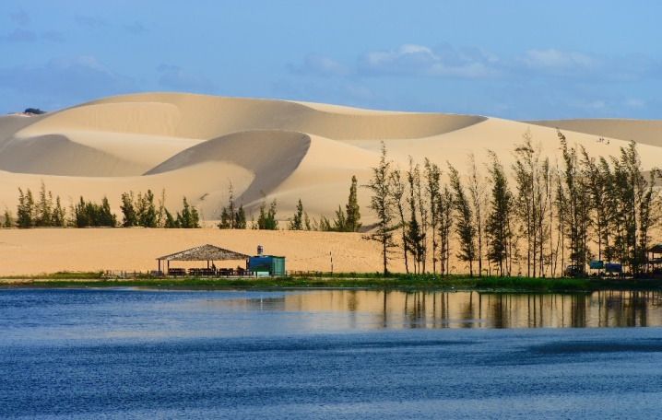
* CHATTING
1. What are the places?
2. What do you know about these places?
3. Have you ever been to these places?”

Slide 4
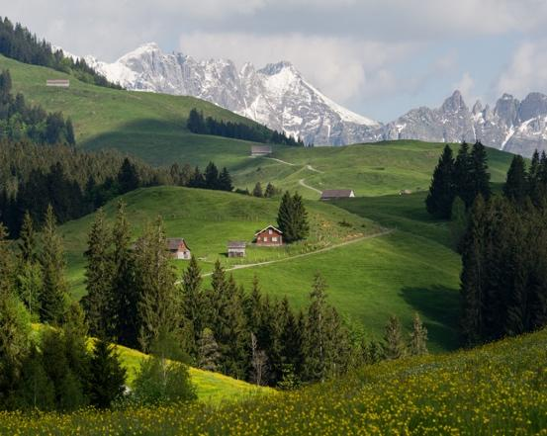
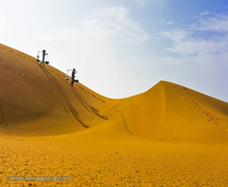
I/ Reading
* Vocabulary:
- tourist attraction (n):
điểm thu hút khách du lịch
- popular (adj)
= well-known, common:
phổ biến
- landscape (n):
phong cảnh
- slope (n):
dốc, sườn
- sand dune (n):
cồn cát

Slide 5
* Checking vocab:
A | B
1. tourist attraction (n):
a. dốc, sườn
2. popular (adj)
b. cồn cát
3. landscape (n):
c. phổ biến
4. slope (n):
d. phong cảnh
5. sand dune (n):
e. điểm thu hút khách du lịch

Slide 6
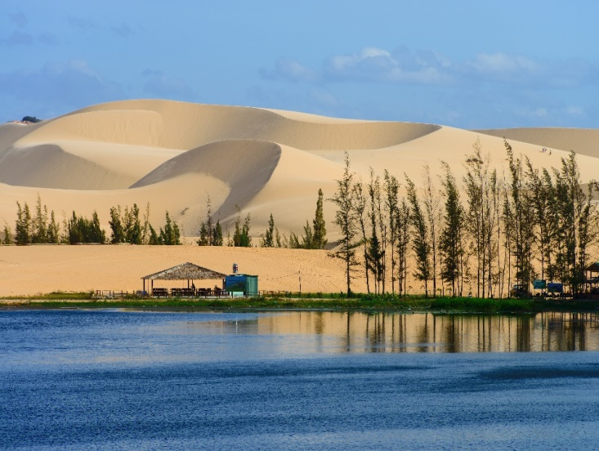
Before you read, look at the pictures below. Make predictions about the reading. Then read and check your ideas.
1. What is the reading about?
2. What do you know about these places?
=> Answer:
1. The reading about Ha Long Bay and Mui Ne - the natural wonders of Vietnam.
2. - Ha Long Bay: is in Quang Ninh, it has many islands and caves. Tuan chau is a tourist attraction
- Mui Ne is in Binh Thuan. It has different colours: white, yellow, red.. It's like desert here.

Slide 7
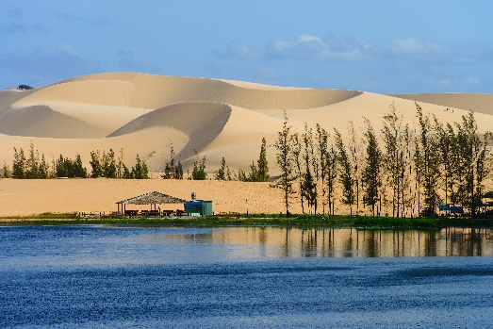
I. Reading:
Ha Long Bay is in Quang Ninh. It has many islands and caves. Tuan Chau, with its beautiful beaches, is a popular tourist attraction in Ha Long Bay. There you can enjoy great seafood. And you can join in exciting activities. Ha Long Bay is Viet Nam’s best natural wonder.
Mui Ne is popular for its amazing landscapes. The sand has different colours: white, yellow, red ... It’s like a desert here. You can ride a bike down the slopes. You can also fly kites, or have a picnic by the beach. The best time to visit the Mui Ne Sand Dunes is early morning or late afternoon. Remember to wear suncream and bring water.

Slide 8
Complete the sentences, using the words from the box.
desert
visit
wonder
islands
remember
island
1.
Ha Long Bay is the famous for its beautiful .
wonder
2.
Ha long Bay is the number one natural in Viet Nam.
desert
3.
A is a large area of land with very little water.
Remember
4.
__________to bring an umbrella, as it often rains there.
5.
A lot of people Ly Son Island in the summer.
visit

Slide 9
GAME: LUCKY NUMBER
1
8
2
Team A
Team B
3
3
5
7
4
8
7
6
1
2
5
1
7
4
8
2
3
6
7
6
4
5
TIẾP

Slide 10
1. Where is Ha Long Bay?
It is in Quang Ninh.

Slide 11
2. What can you do at Ha Long Bay?
We can enjoy (great) seafood and join in exciting activities.

Slide 12
LUCKY NUMBER!

Slide 13
LUCKY NUMBER!

Slide 14
3. Is there a desert in Mui Ne?
No, there isn’t.

Slide 15
4. Where can you have a picnic in Mui Ne?
By the beach.

Slide 16
5. What is the best time to visit the Mui Ne Sand Dunes?
Early morning or late afternoon

Slide 17
You will give a gift.

Slide 18
Read the text again. Answer the following questions.
1.
Where is Ha Long Bay?
It is in Quang Ninh.
2.
What can you do at Ha Long Bay?
We can enjoy (great) seafood and join in exciting activities.
3.
Is there a desert in Mui Ne?
No, there isn’t.
4.
Where can you have a picnic in Mui Ne?
By the beach.
5.
What is the best time to visit the Mui Ne Sand Dunes?
Early morning or late afternoon.

Slide 19
II/ Speaking
Work in pairs. Make notes about one of the places in the reading. You can add your own ideas.
Ha Long Bay | Mui Ne
interesting islands
a beautiful place
- beautiful beaches
- has many islands and caves
- great seafood
- Tuan Chau is the biggest
It’s like a desert
You can ride a bike down the slopes
Visit the Mui Ne Sand Dunes
Mui Ne fishing village
Then tell your partner about the place.
Example:
Ha Long Bay has a lot of interesting islands. It …

Slide 20
Some foreign visitors are visiting your city / town / area. You are their tour guide. Tell them some interesting things about the place as well as what they must and mustn’t do there.
Example:
You must follow all the rules.
You mustn’t take photos when you are in the City Museum.
- You must wear sun scream when you're in My Khe beach
- You must go to the My Khe beach in late afternoon
- You mustn't litter on the beach.
- You mustn't swim alone

Slide 21
HOMEWORK
Learn by heart vocab.
Read text again.
Practice speaking a place you like.
Prepare SKILL 2.

Slide 22
Thank you!
Have a nice day!

Slide 23
